Slide 1
OPIM-5512
Data Science using Pyhton
Sales Forecasting for Better Business Planning
Group-8
Rushikethan Dudipala
Manisha Kharche
Dhatri Datta kiran Nutakki
Santosh Kumar Viranchi Gandham
Venkata Vinayaka Durga Prasant Lakamsani
Duggempudi Lokesh reddy

Slide 2
Agenda
Introduction
Problem statement and research questions
Data collection and preparation
Exploratory data analysis and data visualization
Data preprocessing and feature engineering
Machine learning model selection and evaluation
Results and performance metrics
Conclusion and key takeaways.

Slide 3
Business Problem
The Lack of accurate sales forecasting can result in lost revenue for companies, particularly during peak seasons.
Not achieving projected sales targets can also have a negative impact on stock prices, investor perceptions and probably chance to lose goodwill from valuable customers.
Failure to achieve projected sales targets can have a negative impact on stock prices, investor confidence, and the overall reputation of the company.
Inaccurate sales forecasting can lead to overproduction, overstocking, and increased waste, which can result in financial losses for the company.

Slide 4
Exploration
To implement an effective sales forecasting system that provides accurate predictions.
Identifying the companies to plan better and achieve their sales targets.
Able to identify trends and patterns in sales data to improve decision-making.
To find different sales patterns in the market and to find meaningful insight.

Slide 5
Data Description
We have 4 major data sets of stores.csv, train.csv, test.csv, features.csv
Stores.csv (3 Columns, 45 rows)
This file contains anonymized information about the 45 stores, indicating the type and size of the store.
Train.csv (5 Columns, 421570 rows)
This is the historical training data, which covers 2010-02-05 to 2012-11-01. Within this file you will find the following fields:
Store - the store number
Dept - the department number
Date - the week
Weekly_Sales - sales for the given department in the given store
IsHoliday - whether the week is a special holiday week
Test.csv (4 Columns, 115064 rows)
This file is identical to train.csv, except we have withheld the weekly sales. You must predict the sales for each triplet of store, department, and date in this file.

Slide 6
Data Description
Features.csv (12 Columns, 8190 rows)
This file contains additional data related to the store, department, and regional activity for the given dates. It contains the following fields:
Store - the store number
Date - the week
Temperature - the average temperature in the region
Fuel_Price - the cost of fuel in the region
MarkDown1-5 - anonymized data related to promotional markdowns that Walmart is running. MarkDown data is only available after Nov 2011 and is not available for all stores all the time. Any missing value is marked with an NA.
CPI - the consumer price index
Unemployment - the unemployment rate
IsHoliday - whether the week is a special holiday week

Slide 7
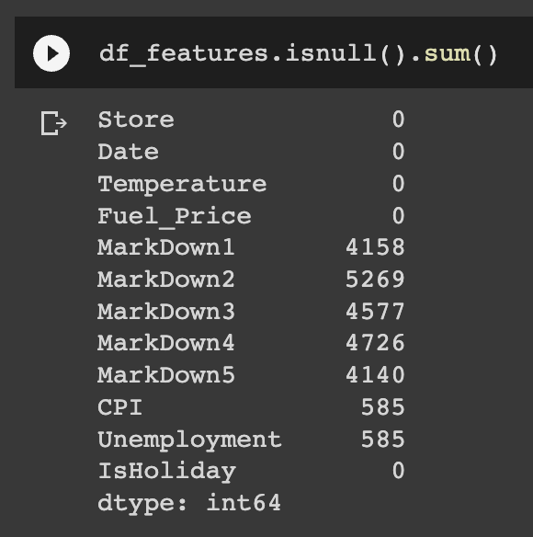
Exploring Null Values
In the Features dataset for the columns, MarkDown1-5 is only available after Nov 2011 and is not available for all stores all the time. Any missing value is marked with an NA.

Slide 8
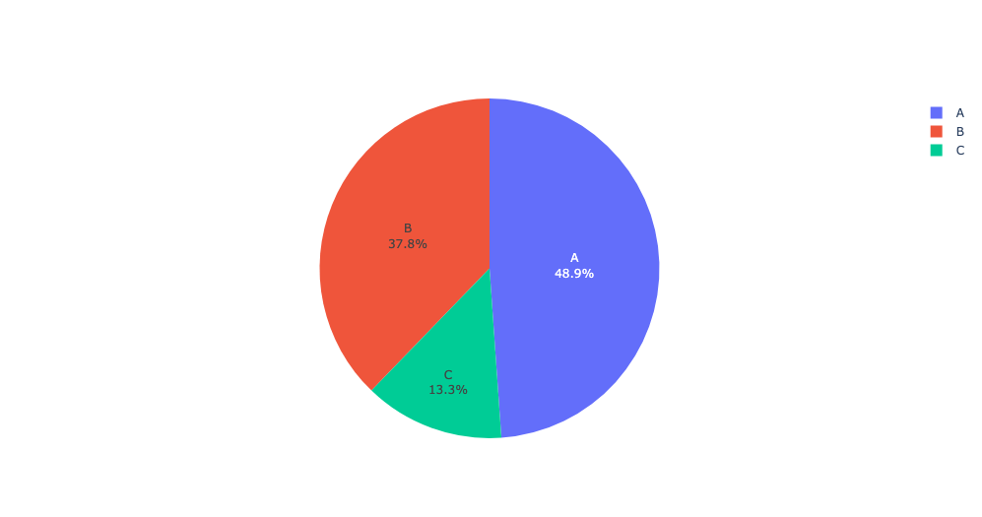
EDA
Visualizing the Type of the Stores along with their percentage in the dataset

Slide 9
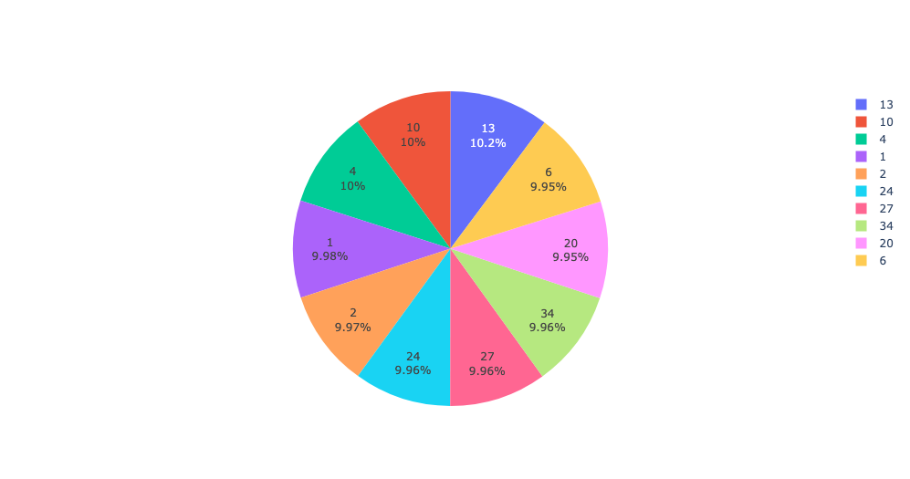
EDA
Visualizing the top 10 store in the train dataset along with their percentage

Slide 10
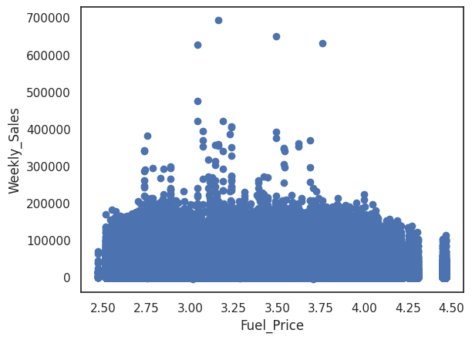
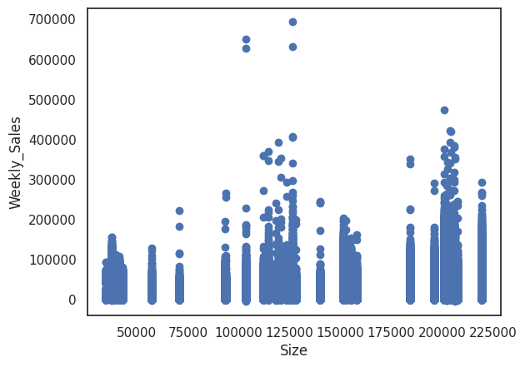
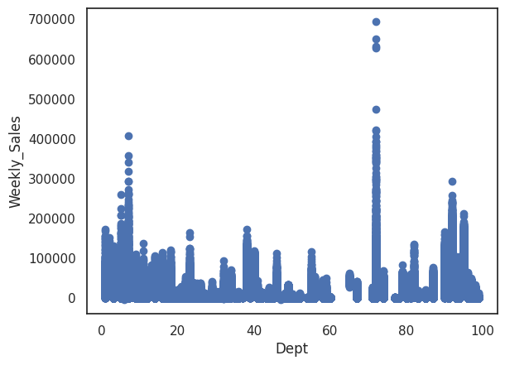
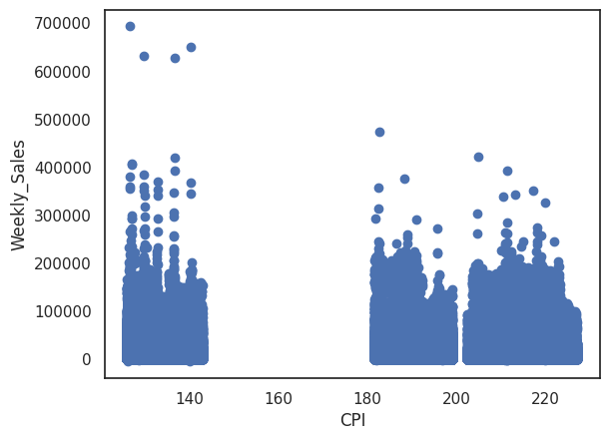
Visualizing every feature with weekly_sales to find the hidden patterns.

Slide 11
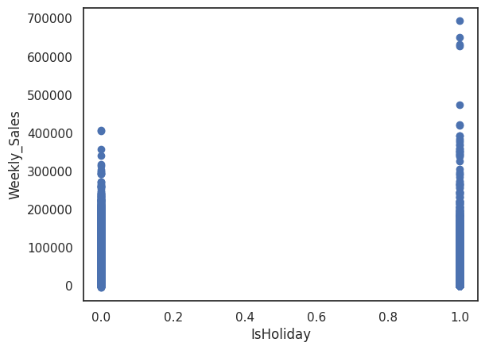
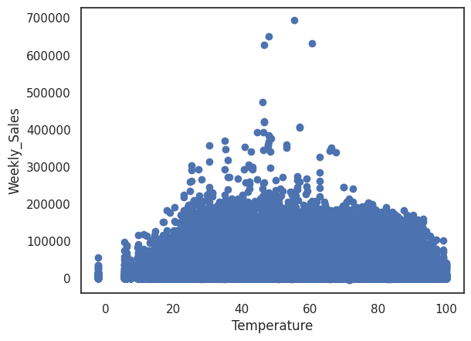
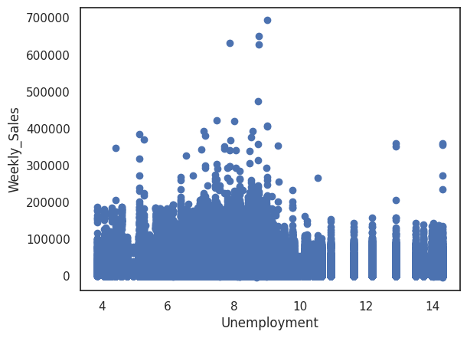
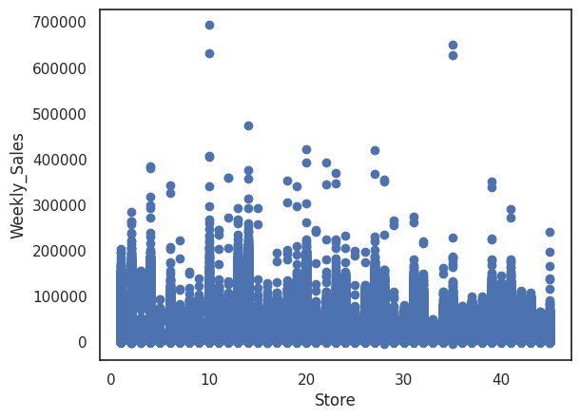
Visualizing every feature with weekly_sales to find the hidden patterns.
Notes:
As expected, holiday average sales are higher than normal dates.

Slide 12
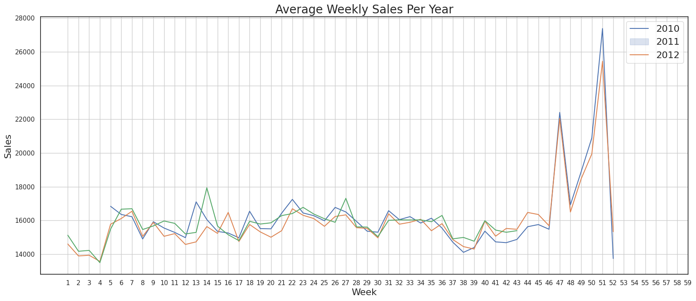
Average Weekly Sales per Year 2010, 2011 & 2012
Notes:
We will review the Average Weekly Sales per Year and check if any additional holiday peak sales were not accounted for in the 'IsHoliday' field.
Top 4 sales belongs to Christmas, Thankgiving and Black Friday times. Interestingly, 22th week of the year is the 5th best sales. It is end of May and the time when schools are closed.

Slide 13
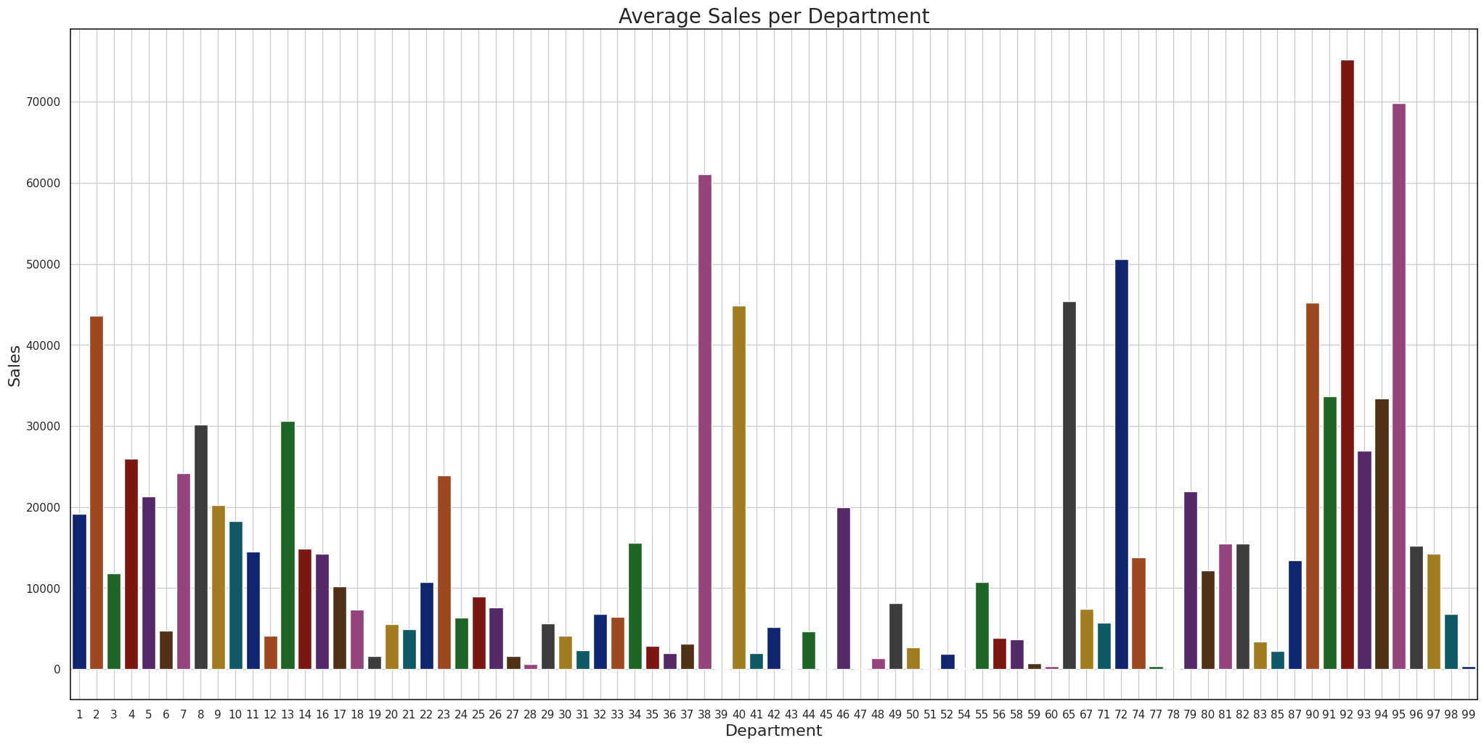
Average Sales per Department

Slide 14
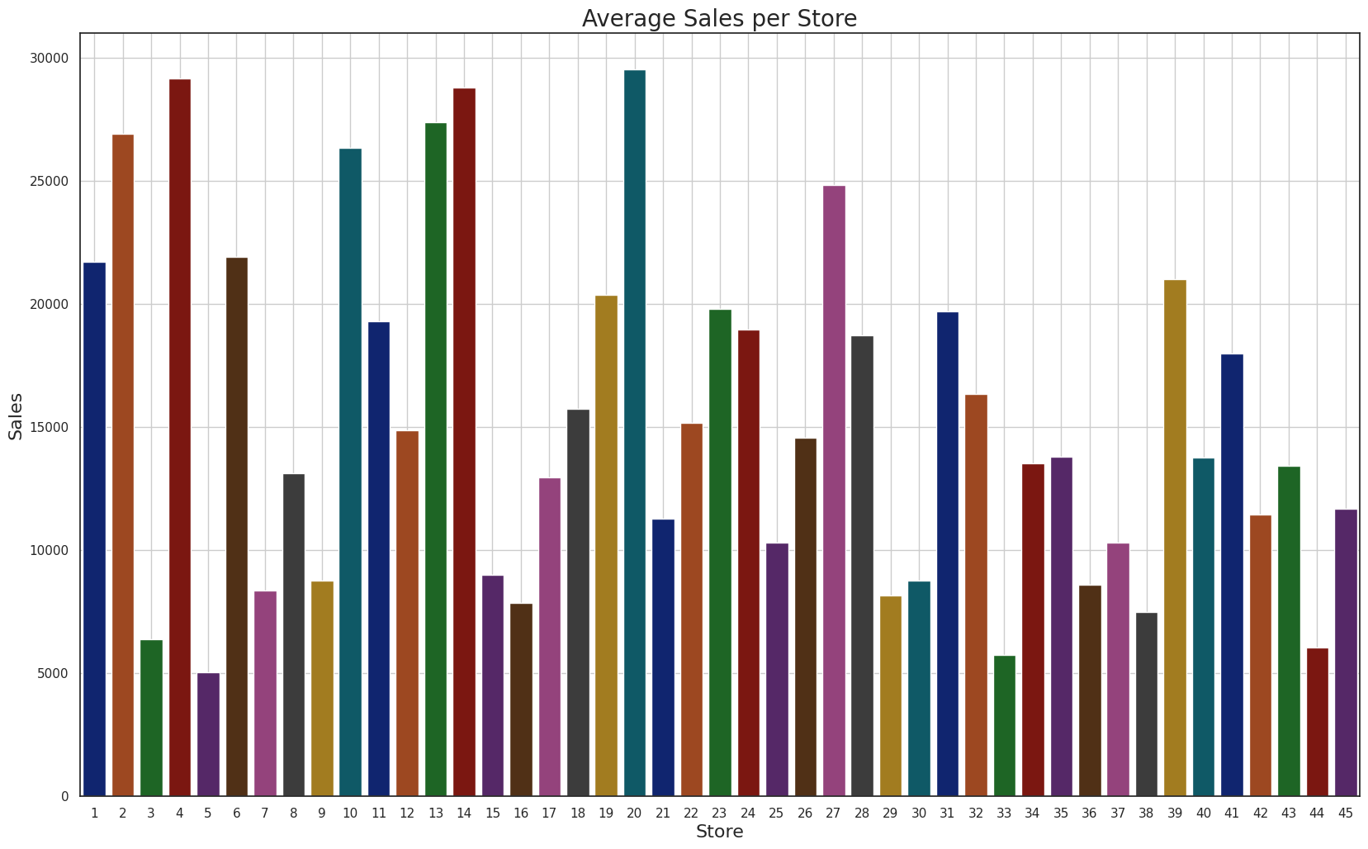
Average Sales per Store

Slide 15
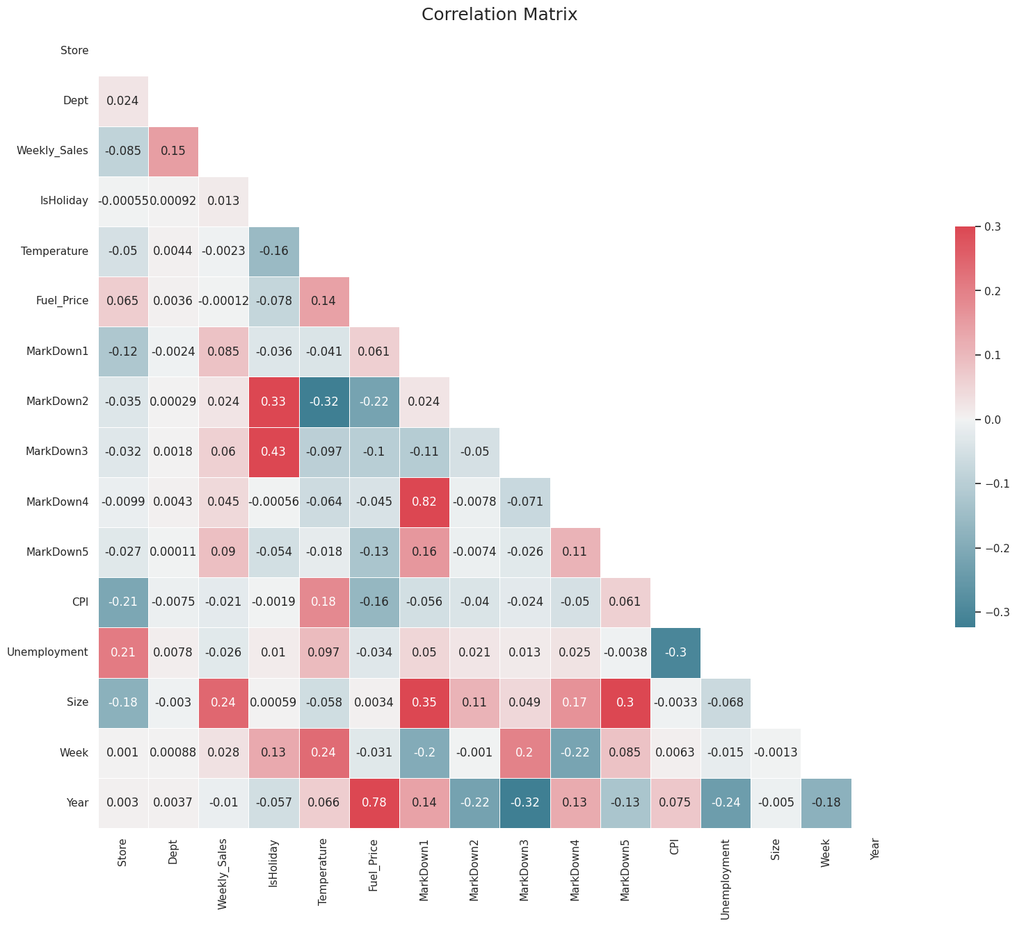
Correlation Matrix
Notes:
Dropping down the variables that have a weak correlation
'Fuel_Price', 'MarkDown1', 'MarkDown2', 'MarkDown3', 'MarkDown4', 'MarkDown5'

Slide 16
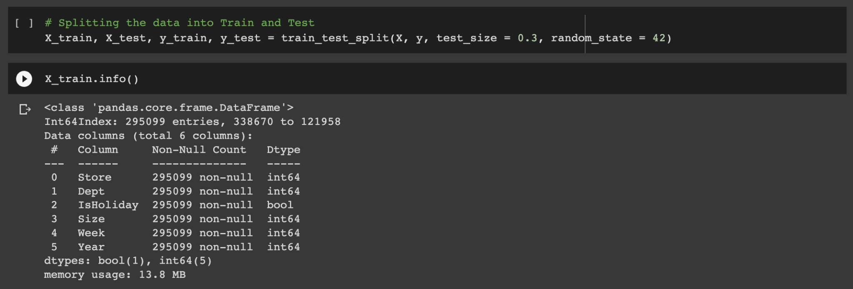
Splitting the Data into Train and Test
Splitted with Train set of 70% and Test set of 30%

Slide 17
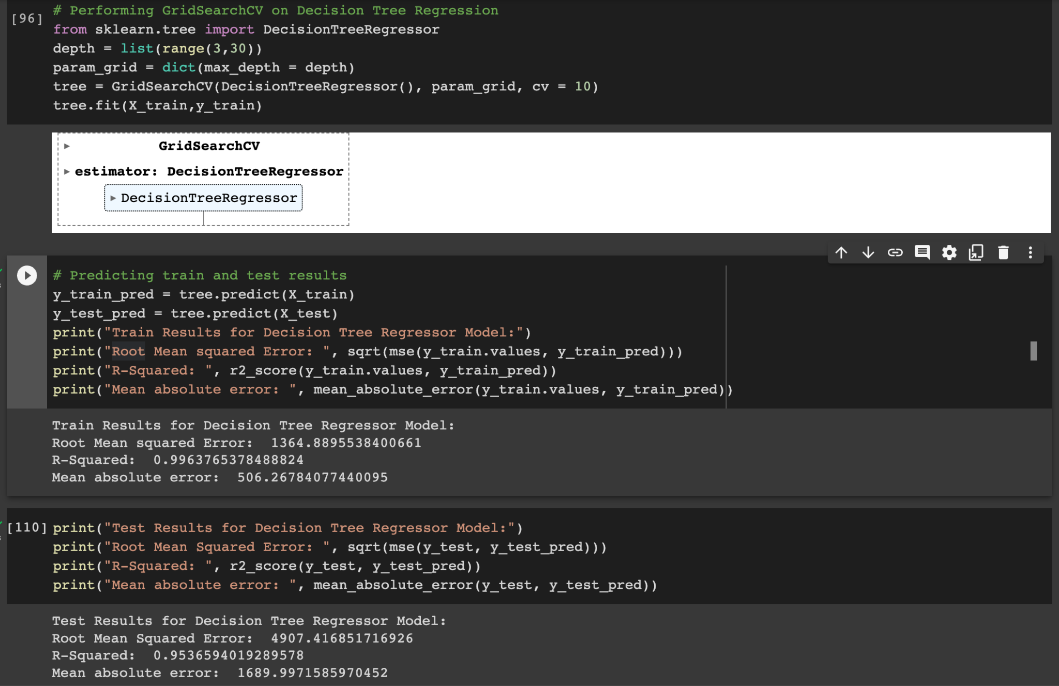
Decision Tree Regression

Slide 18
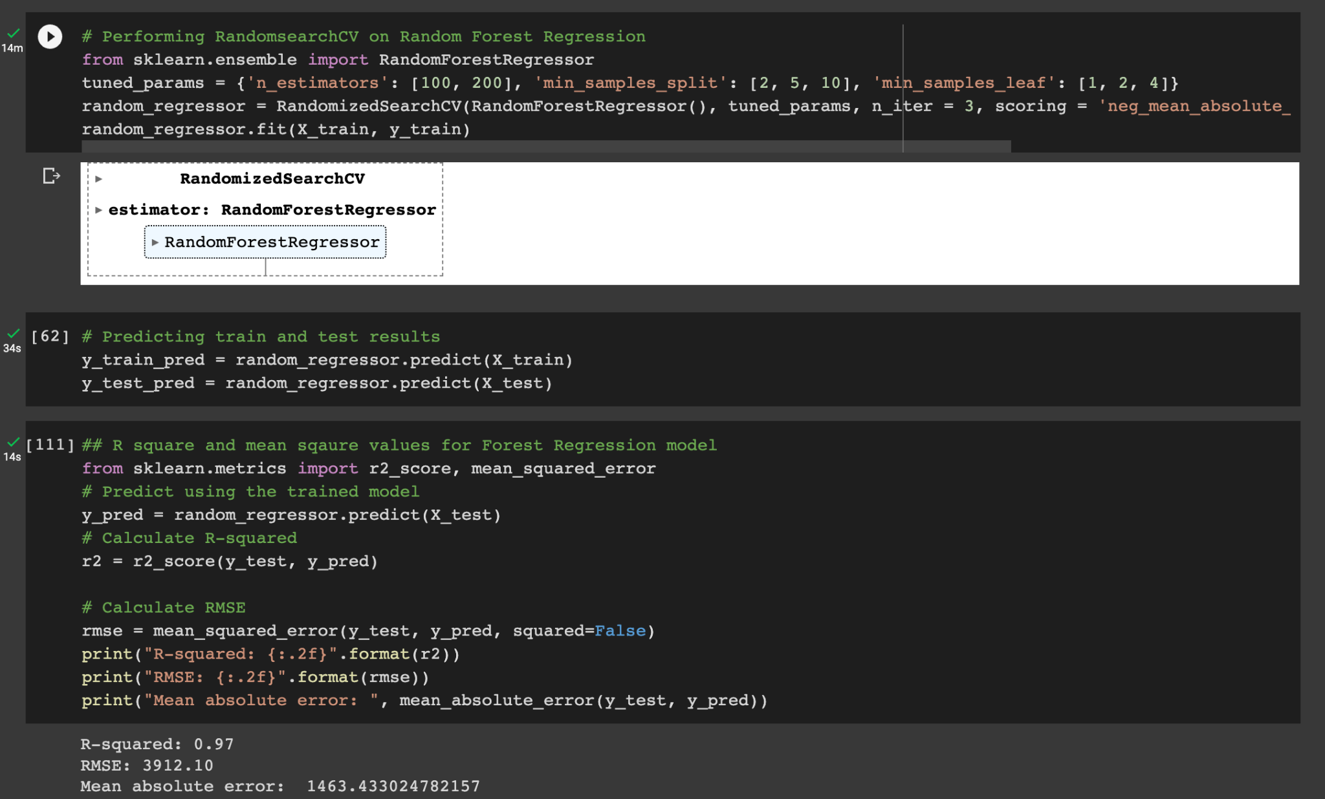
2. Random Forest Regression

Slide 19
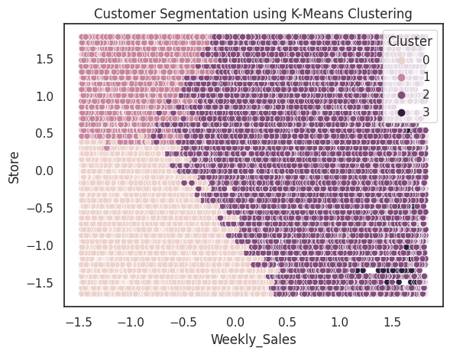
2. Random Forest Regression
Visualizing the Customer segmentation using the K-Mean Clustering.

Slide 20
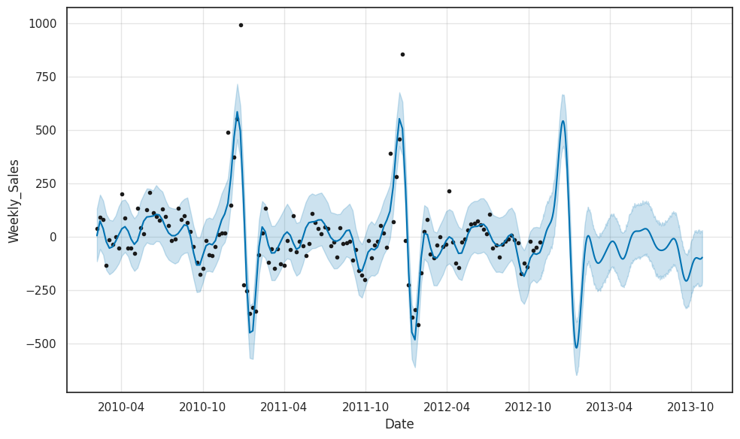
3. Time Series Model (Prophet Model)

Slide 21
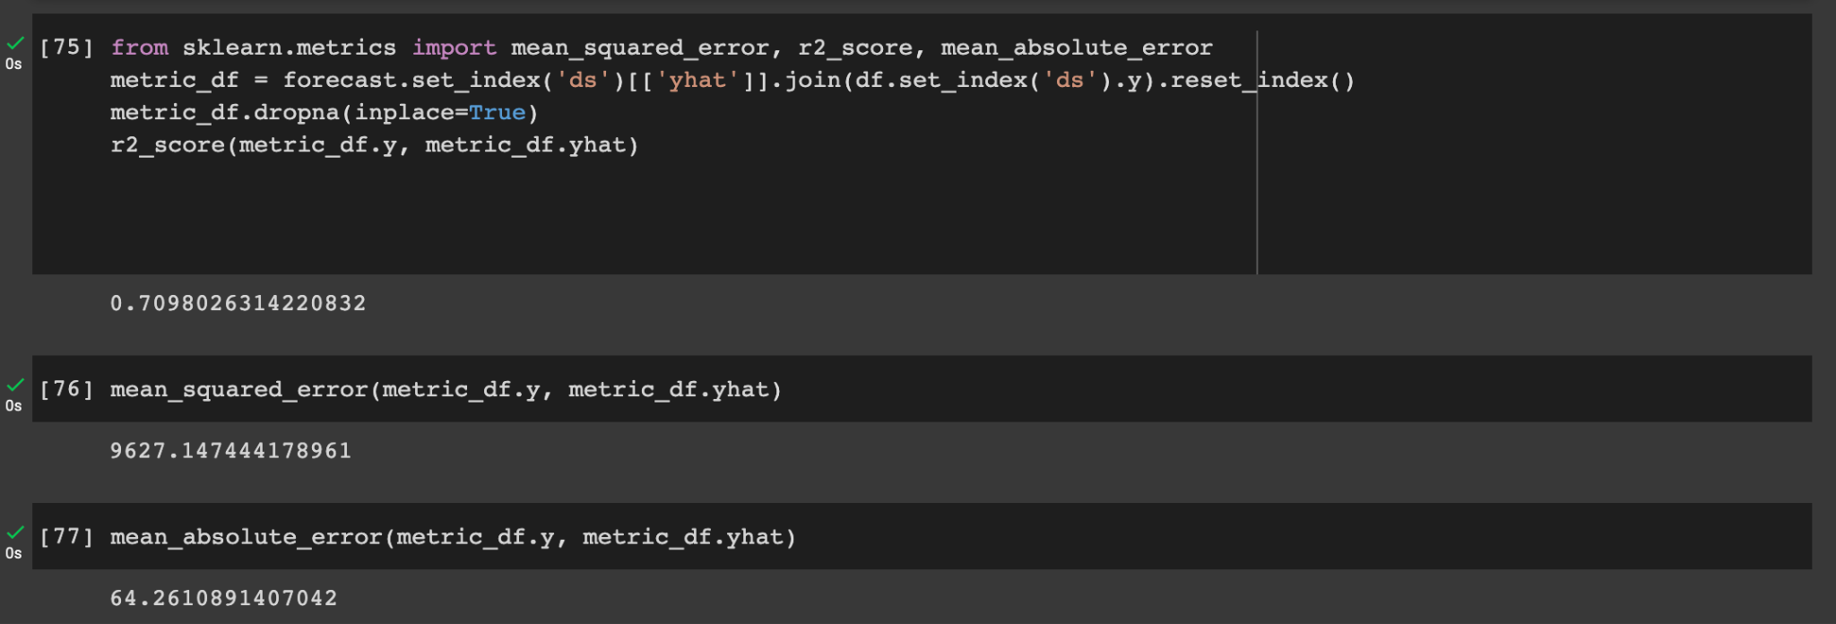
3. Time Series Model (Prophet Model)
Notes:
Based on the time-series forecasting analysis, we can see that the sales for the given dataset generally increased over time with some seasonal fluctuations. The forecast model predicts a continuing upward trend in sales for the next year, with a peak in sales around mid-2014.
The predicted sales values can be used to plan for future demand and optimize inventory levels. Additionally, the forecast model can be adjusted and improved over time as more data becomes available, allowing for more accurate predictions and better supply chain management.
R square is 0.7098 and we can say that it is not good model to predict future sales.
We can see some trends where the sale sare high during november and December in every year due to Hoiliday Season

Slide 22
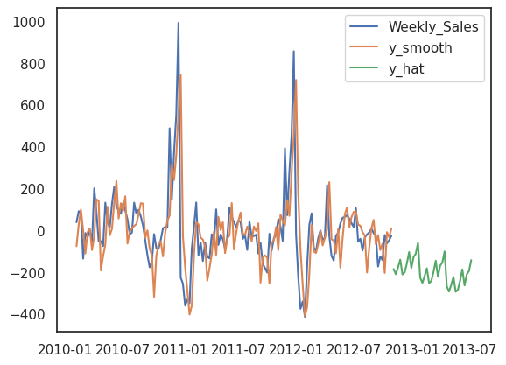
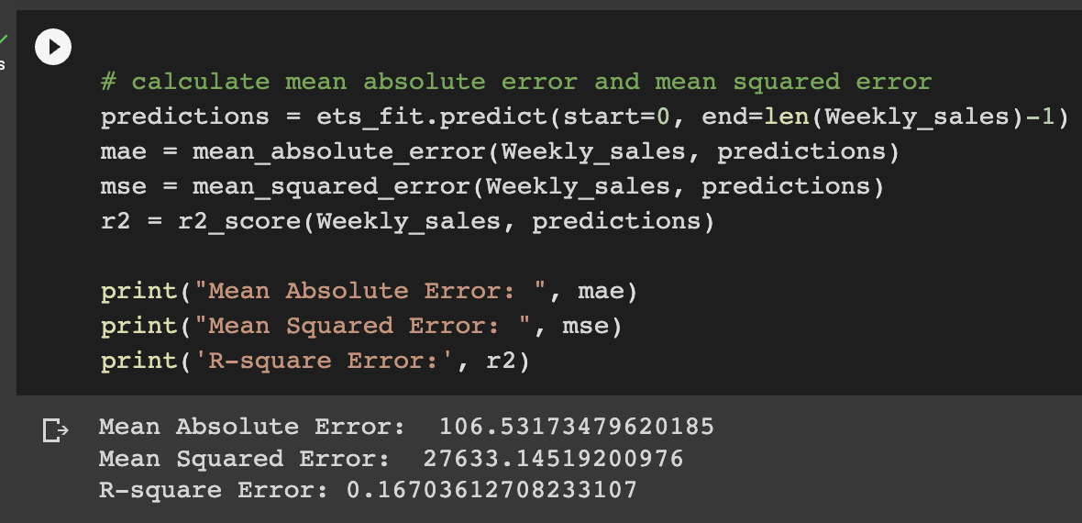
4. Exponential Smoothing Model

Slide 23
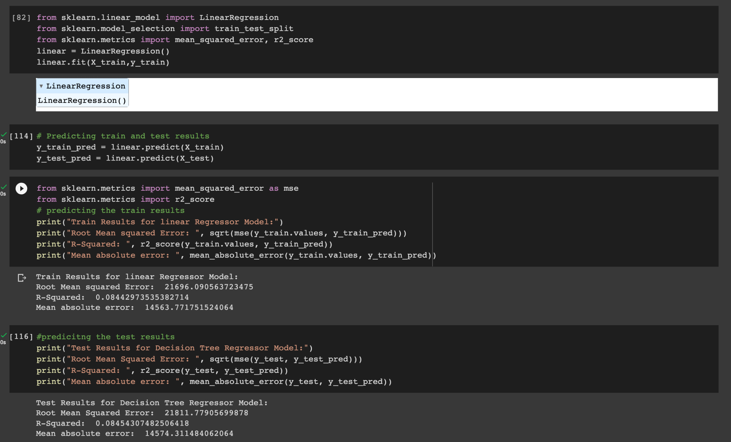
5. Linear Regression

Slide 24
Performance Metrics
 | R-Square(R2) | RMSE | MAE
Decision Tree Regresson | 0.953 | 4907.4 | 1689.9
Random Forest Regression | 0.97 | 3912.1 | 1463.4
Time Series Prophet Model | 0.71 | 98.2 | 64.26
Exponential Smoothing Model | 0.167 | 27633.2 | 106.5
Linear Regression | 0.08 | 21811.8 | 14574.3

Slide 25
Conclusion/Business Value
Stores with high sales : Type A stores has big store size,large number of departments and small markdown values.
Stores with low sales: Type C stores has small store size,small number of departments and low markdown values.
Promotional Markdown events before holidays seem to increase sales.
Sales seems to be highest during the week of Thanksgiving and 3 weeks after Thanksgiving and Christmas time.

Slide 26
Business Value
An important aspect of this is to try and understand buying behavior based on regional and departmental sales.
Walmart can grow its online retail business massively and gather huge profits with already established stores and warehouses.
It is easier for the organization to create a nationwide reach,limiting the presence of physical stores and helping their customers save on fuel costs by delivering goods at their doorstep.

Slide 27
THANK YOU

